Slide 1
VII. – PROJECT COMMENCEMENT
Usually, the first step in a new fuel system project is the bidding process. This is where pencils are sharpened, and you put your game face on, for it’s a competition. Right? Yes! To the victor goes the contract! Let the gloating begin! Once you’re through with your happy dance, it’s time to get down and serious. The real work is about to begin.
Lists are made. Tanks, dispensers, sumps, piping, other major components, and parts are ordered according to the project specifications. A Site-Specific Safety plan is prepared to meet OSHA requirements.

Slide 3
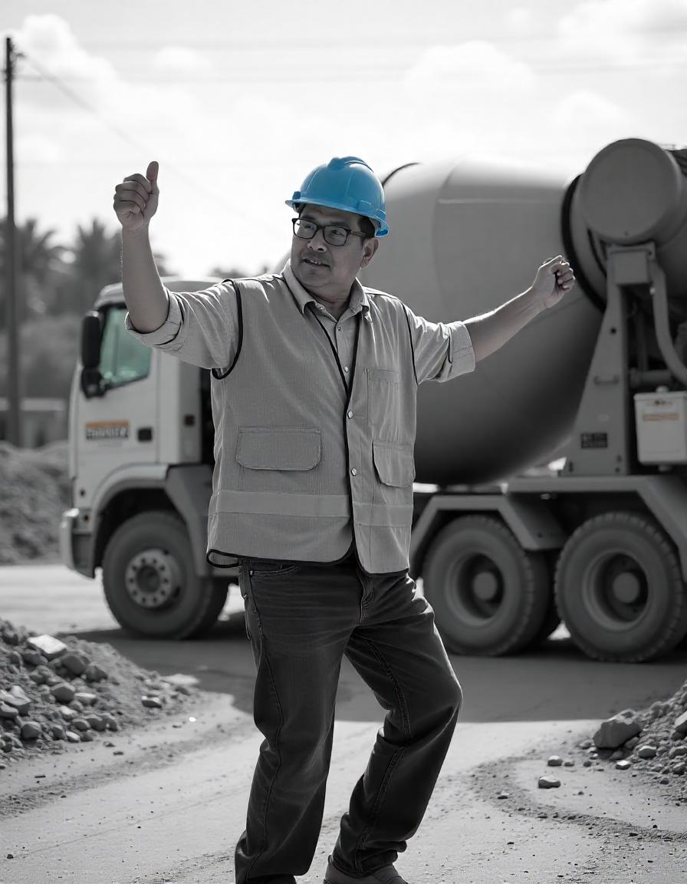

Slide 5
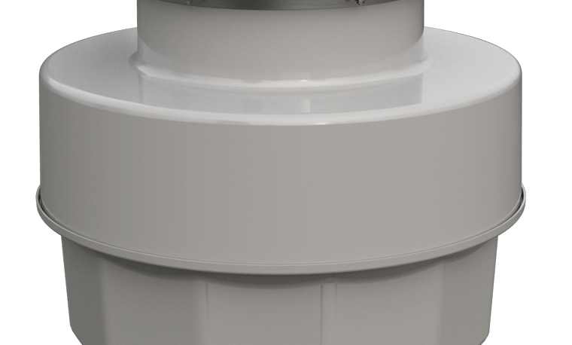
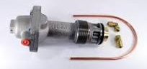
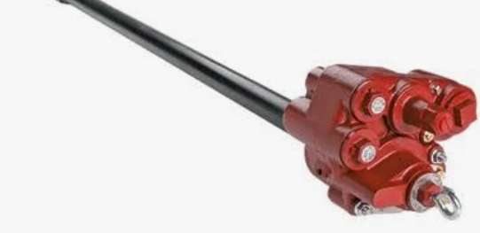
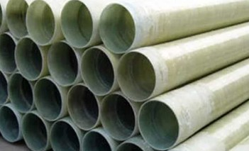

Slide 6
Is the company’s credentials up to date and everyone current with their licenses? ARE YOU KIDDING ME RIGHT NOW? Of course!. How stupid of me to bring something so academically bizarre up. Surprisingly enough, it does happen. There have been times when contractors and/or license holders have been so busy with projects that their renewals have slipped by them and in essence, their credentials are EXPIRED, brought to their attention by a city or state inspector conducting a project inspection. At this time, you’re deep in the project and a lot of tasks have been performed ILLEGALLY. Oh dear! Oh my! Well, we know the drill from here, and it ain’t pretty. More about this in another module.

Slide 7
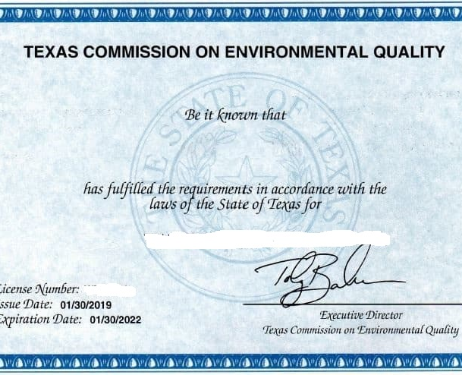

Slide 8
Tank and piping manufacturer’s installation training also expires. Some manufacturers recommend retraining installers every thirty-six months.
Having installation crews that are routinely trained every thirty-six months not only keeps installers well informed, it also gives the company a sharp, competitive edge against other companies who don’t. And there are those who deem this an unnecessary waste of time because, afterall, they’ve installed north of a hundred tanks and KNOW what’s in those installation books.
Checking credentials is not time consuming, it’s just a simple check, look in the files, pose the question to the license holder, “Are you up to date?”. The company may have someone responsible for keeping all company credentials up to date and that’s even better. PROBLEM SOLVED! Quit your worrying, Tim!

Slide 9
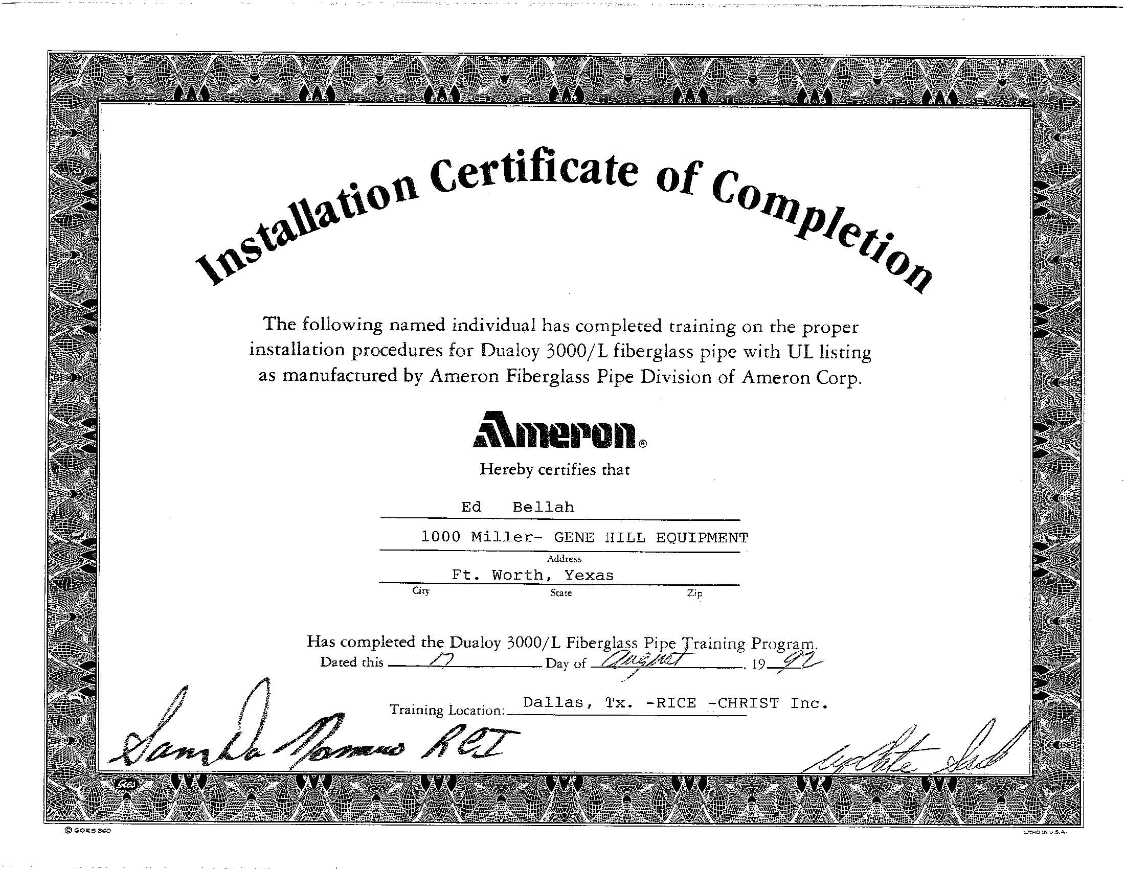
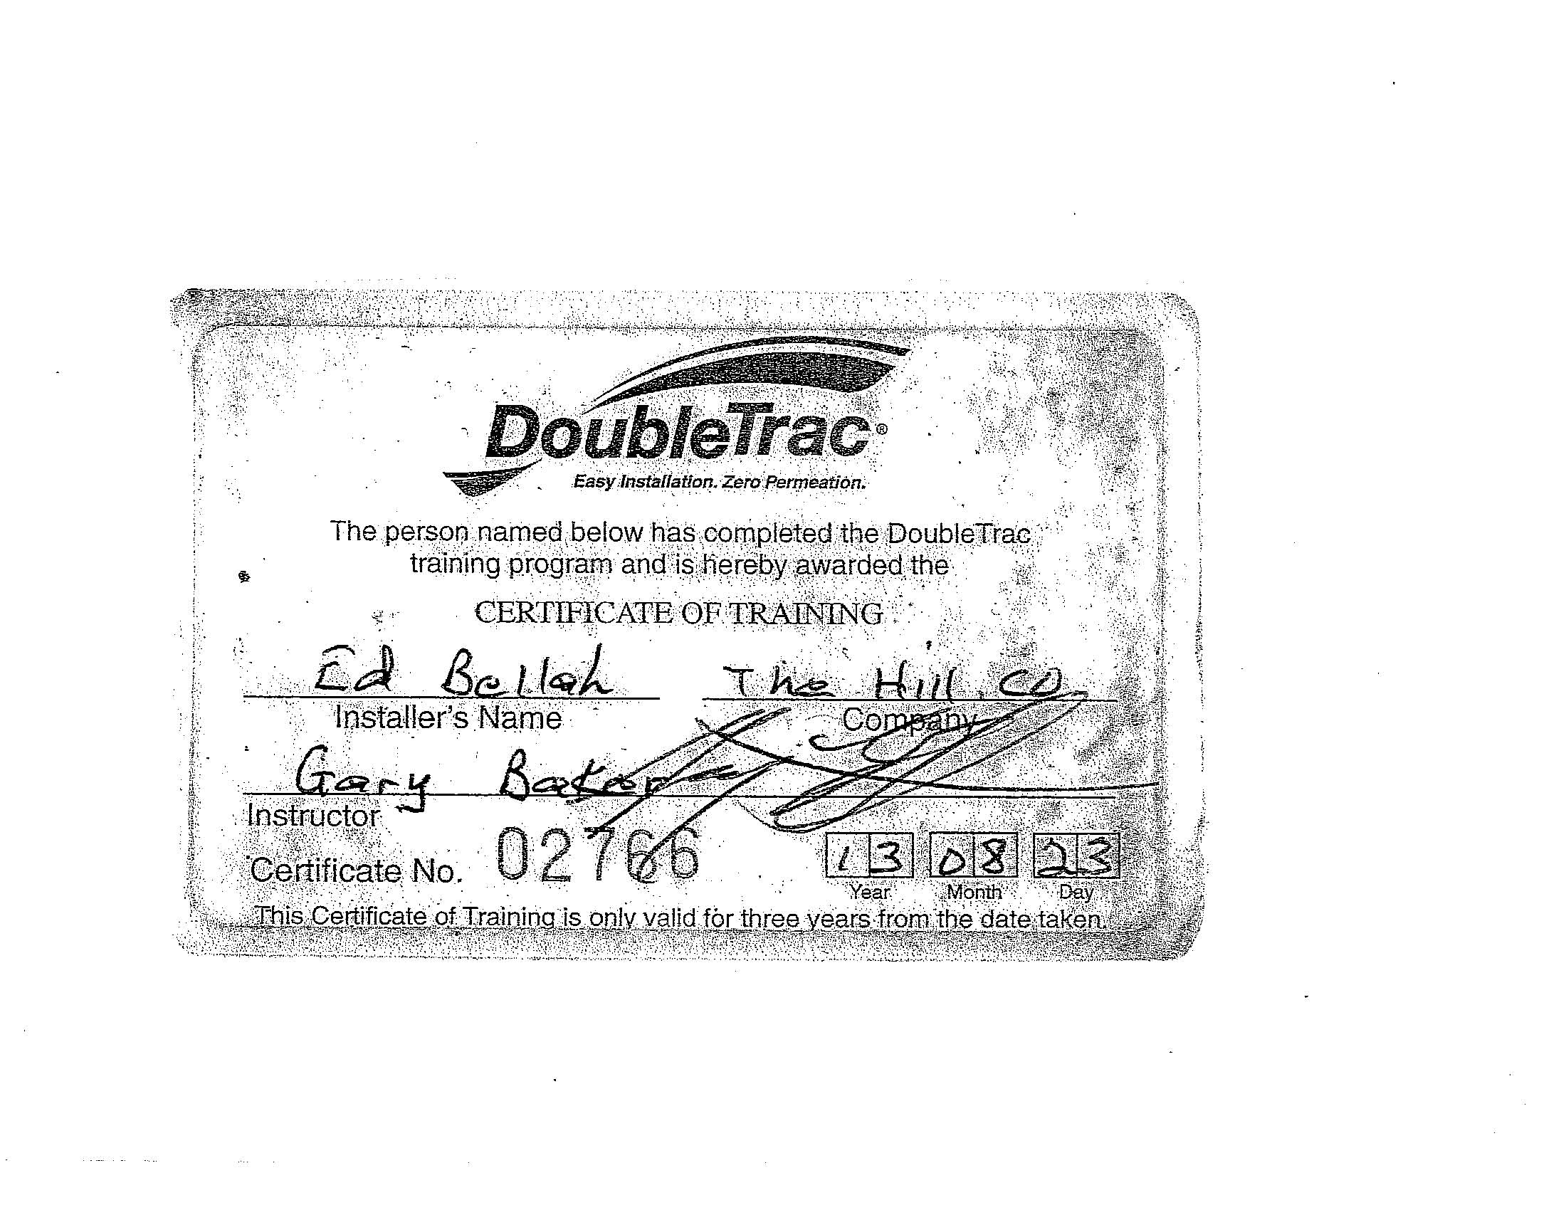
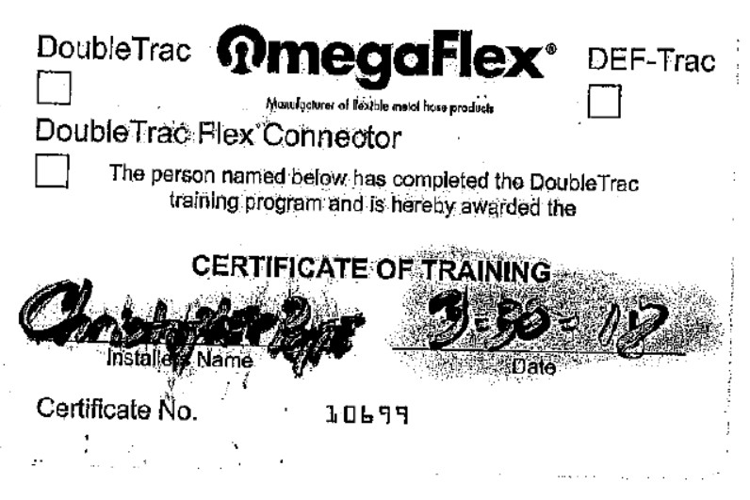
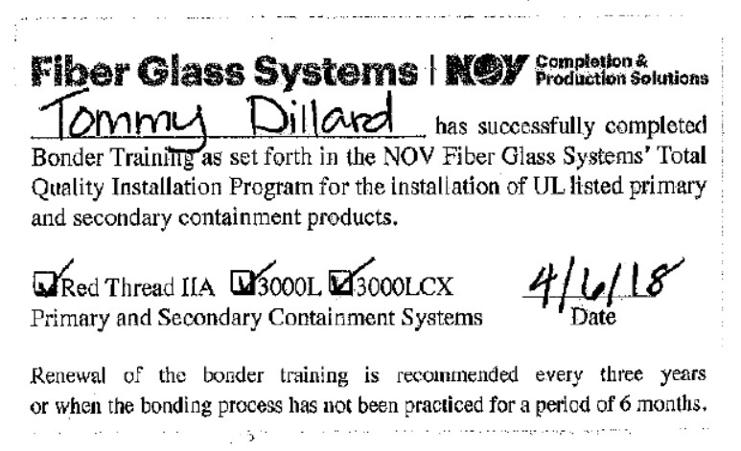

Slide 10
Contingency plans for handling unexpected subsurface conditions are discussed and plans are devised to handle them accordingly. At this point, you already have pricing from your subcontractors, now scheduling their phases of work begins.
The 30-day construction notification is sent to the state. The permitting process begins with the city where the work is to be performed. Most jurisdictions will ask for the state construction notification and because you handled this first, you present it with your permit documents.

Slide 11
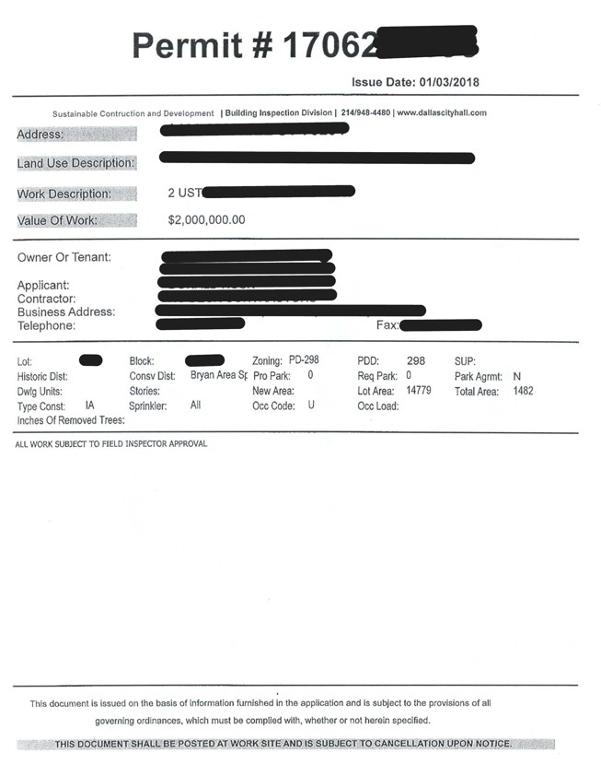
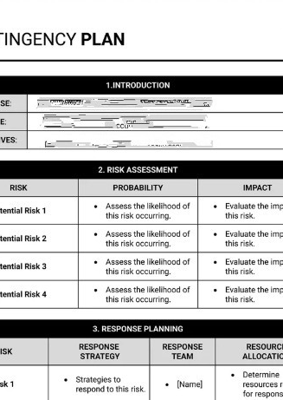

Slide 12
A call is placed to the state’s One Call System to have Underground Utilities located at the project site. The call should be placed at least 2 days in advance of your dig but not more than 14 days.
The marks are typically VALID for 14 days. So, it’s a good idea to have remarks done weekly. How come? Because marks are not always permanent, they disappear, or heavy equipment flattens flag markers. It doesn’t cost anything in cash or time to make that call and it’s cheap insurance.
The Texas One Call law is found in the Utilities Code, Chapter 251. It is very important to know this code because not following it carries very serious civil and criminal penalties for violations.

Slide 13
The excavator is responsible for making the one-call notification, not the facility owner.
It’s important to know that underground utility markers have a tolerance and knowing what those tolerances are and dig outside of them.
You MUST notify the one-call center if it’s determined that one or more utilities have not responded to a locate request. Do gamble with this and think that you’ve done your job and made the call and YOU’RE in the clear and all is okay to proceed, that it falls on THEM now. That’s not the case.

Slide 14
If a buried utility is damaged during excavating procedures, stop immediately and call the one-call center to report the damage.
Damages may include gouges, dents or breaks to coatings, cable sheaths, and cathodic protection anodes or wiring. If a utility is exposed, you should call the center to report it.
Give the utility a reasonable amount of time to make the repair.
If there is damage to a buried gas line and you can smell gas, evacuate the area immediately and call 911. Do not start any internal combustion engines.

Slide 15
A preconstruction meeting may be held at the site to familiarize everyone with site conditions and the overall project objectives.
In attendance should be your subcontractors; excavator, electrician, backfill material supplier, material haulers, concrete contractor, and of course the owner. It’s not a bad idea to invite the AHJ and if they’re able to attend, could offer some valuable insight as to what phases of the project they’ll be interested in seeing.
During the site walk-through, overhead utilities may be identified, as well as other obstacles that, if not known about prior to project commencement, could possibly cause some grief, or a couple of days downtime while the obstacle is investigated and abated. By discovering it during the site walk, it can easily be resolved and out of the way by the time installation crews mobilize to the site.

Slide 16
It’s a really good idea to photograph the site now, before any construction activity occurs. Photos provide visualizations so you don’t have to return to the site again and again to make verifications of what you saw during the site walk. And this one simple step of taking photographs, could prove extremely valuable to you at project completion.
A lot can happen during construction so it’s always advisable to conduct a site walk with the owner at project’s end. During this punch-list walk, it’s customary for each of you to discuss project specifications and point out how those specifications were accomplished. It’s also time to identify uncompleted or missing tasks that need attention.

Slide 17
The owner may see some peripheral damage to the property and accuse your crew of causing that damage. This could be an innocent accusation simply because the owner was unaware that the damage existed, maybe for a very long time, and assumed, simply because he had never noticed it, that it was caused during construction.
Or there’s that possibly that the owner knew about the damage and saw a golden opportunity to get the damage repaired, by you, at no cost to him. Your preconstruction photography could come in extremely handy in a situation like this. And, of course, there are lots of other valid reasons for having preconstruction photographs, some that may not even reveal themselves until months or years later.

Slide 18
When ordering pea gravel, make it clear with your material supplier that you will require sieve analysis and written certification that the
materials they are providing conforms to your tank manufacturer’s requirements, ASTM International, formerly the American Society for Testing and Materials (ASTM) Standard C 33, ASTM Standard D 448, American Association of State Highway and Transportation Officials (AASHTO) Standard M 43, and any other applicable specifications.
Asking for this documentation after the installation will be too late. FRP UST manufacturers highly recommend attaching sieve analysis to their Tank Installation Checklists for warranty considerations. This simple step could make or break a tank owner’s warranty claim if the need ever rises.

Slide 19
The tank installation manual needs to be read thoroughly before the project commences and the installation team needs to have a command knowledge of what all is recommended in the manufacturer’s instructions.
“WHY? We just installed four tanks about three or four months ago and before that, PSHAW, Hundreds! We know what the manual says!” Because manufacturers change recommendations periodically and it’s up to you, you’re the professional here, to stay on top of those changes, be ultimately familiar with the manuals and their revision dates. A change in a title page design may be the first clue that some instruction inside the manual has changed, something may have been added or altered in some manner and you need to know what that is. So, if the title page design has changed, you certainly look next to see if the revision date has also changed and if it has, start reading the entire manual. The point is to not become complacent with what you THINK you know the manual contains. You need to KNOW with all certainty.

Slide 20
The installation team needs to know that federal and state regulations trump the manufacturer’s recommendations and even the industry standard of care. They also need to know how, when, why, and where to apply industry recommended practices, fire codes, and OSHA safety requirements into the project.
These entities form somewhat of an hierarchy so knowing what role each of them plays, and when, is vital to the construction team.

Slide 21
Prior to project commencement, assurance should be made that all components being installed are compatible with the stored regulated substances and that they meet project specifications.
Always keep in mind that all steel constructed components need to be protected from corrosion by either being constructed of non-corrodible materials or isolated from soils and groundwater by wrapping, coating, or placement inside secondary containment devices, such as containment sumps.

Slide 22
When tanks are delivered to the project site a thorough inspection needs to be made of their outer shells. Any scratches, scars, or blemishes that cause suspicion should be notated on the Bill of Lading. A careful assessment is needed to ascertain whether the suspected area is superficial scarring or merits notifying the tank manufacturer.
If it’s merely superficial scarring, in most instances it’s probably something you can repair in the field. Remember, any repair must be performed strictly following manufacturer’s recommendations.
However, if there’s any dents, gashes, or cracks, you probably want to notify the tank manufacturer and send photos to them and let them decide if the damage merits sending one of their factory trained techs.

Slide 23
It doesn’t matter how insignificant your concern, if there is one iota of doubt about the tank’s appearance, simply notate it on the document. If it’s proved later to be nothing, no harm has been done. On the other hand, if it turns out to be an issue and the area of suspicion DOES turn out to be a significant problem, the notation is there on the document, the day it was delivered. Makes it easier to make a case rather than call foul after the fact with no documentation to back it up.

Slide 24
As durable as tanks are, both steel and fiberglass, you must exercise care in handling them. They are made to withstand lifting and handling during transportation, and obviously, stand up to their normal function as a storage vessel for fuel.
The manufacturers and industry RPs tell you they must not be dropped, dragged, or rolled. Yes, manufacturers do make an allowance for rolling during inspection and pressure soap tests, a tank may be rolled no more than 120 degrees for these purposes. And then only on a clean, level surface that is free of any debris that could consist of sharp objects, which may have the potential to damage the tank’s shell.

Slide 25
When rolling a tank for inspection or testing purposes, be sure that bungs, fittings, nor collars ever contact the ground. Imagine a tank sitting upside down on solid ground. That’s a lot of weight for bungs and collars to support. That’s a lot of weight they are not designed to support.
Never wrap chains or cables around the tank shell.

Slide 26
The tank excavation and piping trenches must provide adequate vertical and horizontal space for the tanks, piping, and all associated equipment and must allow for the proper placement and compaction of bedding and backfill materials. It must also provide ample cover and paving to accommodate the anticipated traffic loads.
Excavations must be performed in a manner that will avoid undermining foundations and any other existing structures. Excavation must be not less than three feet from the base of any adjacent structures and not less than three feet from any underground utility easements and property lines. You’ll always want to confirm these distances with your AHJ.

Slide 27
The tank excavation bedding and backfill material must consist of clean, washed, suitably graded, and noncorrosive sand, crushed rock, or pea gravel.
Placing tanks or piping directly on native soils, concrete pads or saddles, or any other underlayment except the bedding materials, previously stated, is prohibited by rule and tank manufacturers.
USTs located in areas subject to high water tables or flooding are required to be protected from any flotation or movement which could jeopardize the integrity of the UST system.

Slide 28
Any methods used to prevent tank flotation has to be in accordance with the tank manufacturer's specifications. To accomplish this, you can use one of the following methods or a combination of them:
the use of ample backfill and/or paving on top of the tank to offset the buoyancy forces;
the installation of a properly designed deadman anchoring system, where the concrete beams are placed outside the tank’s shadow and where the length of the beams extend at least one foot beyond the ends of the tank; or;

Slide 29
the installation of a properly designed concrete hold-down pad anchoring system beneath the tank, where the pad's width and length extend at least one foot beyond the tank sides and ends in all directions.
The installation of anchoring straps or cables shall be in accordance with the tank manufacturer's specifications. All parts of the straps, cables, and hardware shall be of corrosion-resistant material or, if metallic, shall be thoroughly coated or wrapped with a suitable dielectric material.

Slide 30
The piping layout has to be designed so it minimizes crossing over of other lines and conduits, and crossing over the tops of adjacent tanks and other UST system components. If crossing pipes is unavoidable, adequate clearance must be provided to prevent contact with other pipes. And this crossing method must be done in accordance with your pipe manufacturer’s specifications.
You must avoid the formation of traps or sags in the piping. All of the piping must slope at least 1/8 inch per foot in the direction of the tank.

Slide 31
All piping joints must be cut accurately, deburred, cleaned, and sealed with the appropriate pipe sealant, bonding agent, or adhesive in accordance with the piping manufacturer's specifications so a liquid-tight connection is achieved. Always keep in mind to use sealants that are compatible with the stored regulated substance.

Slide 32
Air testing new tanks must be conducted in accordance with the tank manufacturer's specifications.
Air testing for single-wall tanks includes soaping all surfaces, seams, and fittings, while pressurized with three to five pounds per square inch gauge (psig) air pressure for at least one hour, monitoring the gauge for pressure drops, and inspecting for bubbles.
Gauges used for air testing must have a maximum range not exceeding 15 psig. All tanks undergoing air pressure testing must be equipped with a pressure relief device capable of relieving the total output of the compressed air source at a pressure of not more than six psig.

Slide 33
Air testing new piping, fittings, and valves must be conducted in accordance with the manufacturer's specifications.
New piping must be tested before being covered and placed into use.
Air testing of piping has to include the soaping of all joints, pressurizing with compressed air to 150% of the maximum piping operating pressure, or a minimum of 50 psig, for at least one hour, and inspecting for bubbles.

Slide 34
In addition to the air tests, a precision tank tightness test and piping tightness test must be performed after the backfill has been placed but prior to bringing the new UST system into operation.
For fiberglass-reinforced plastic tanks, the tank diameter has to be accurately measured prior to and after installation to determine the amount of vertical deflection, as specified in the tank manufacturer's installation procedures. Except when specifically authorized in writing by an authorized representative of the tank manufacturer, tanks shall not be placed into operation if the measured vertical deflection exceeds the manufacturer's maximum allowable deflection ratings.

Slide 35
For steel tanks and other underground UST system components which are equipped with factory-installed or field-installed cathodic corrosion protection systems, the cathodic protection systems must be tested for operability and adequacy of protection by a qualified corrosion technician or qualified corrosion specialist after the UST system installation is completed but prior to placing the system into operation.

Slide 36
The installation of double-wall tanks must comply with the manufacturer's specifications and the applicable tank installation procedures specified by the AHJ such as:
(B) Air testing for double-wall tanks must follow the manufacturer's specifications or these following procedures:
(i) The primary tank is pressurized and gauged with three to five psig of air pressure. The primary tank is pressurized for at least one hour, and the gauge pressure is periodically monitored for any pressure drops.

Slide 37
(ii) After disconnecting the outside air supply source, the interstitial space between the tank walls shall be pressurized utilizing the pressure from the primary tank. A second gauge shall be used to measure the pressure in the interstitial space.
(iii) The exterior of the tank must be soaped, and the integrity of the system must be inspected by monitoring the gauges and inspecting for air bubbles for at least one hour prior to releasing the pressure.
(iv) Gauges used in air testing procedures must have a maximum range not exceeding 15 psig. All tanks undergoing air testing shall be equipped with a pressure relief device that is capable of relieving the total output of the compressed air supply at a pressure not more than six psig.

Slide 38
The installation of double-wall piping shall be in compliance with the manufacturer's specifications.
After successful air testing of the completed primary piping system, the secondary containment piping must be air tested in accordance with the manufacturer's specifications and these following procedures.
(i) The secondary containment piping shall be pressurized and gauged with three to five psig of air pressure.
(ii) The exterior of the secondary containment piping shall be soaped and the integrity of the system shall be inspected by monitoring for air bubbles for at least one hour.
(iii) The secondary containment piping system shall remain pressurized, and the gauges shall be periodically monitored for pressure losses, until the entire UST system installation is complete in order to monitor for damages during the remaining construction activities.

Slide 39
General requirements for both monitoring wells and observation wells.
All monitoring wells and observation wells shall be constructed or installed by personnel possessing the appropriate skills, experience, competence, and, if applicable, any required license or certification to complete the construction or installation in accordance with recognized industry standards and regulatory requirements.
The well casing material shall be sufficiently compatible with the stored regulated substance such that prolonged exposure to such substances will not cause failure or excessive deterioration of the casing.

Slide 40
All monitoring wells and observation wells must be properly capped, labeled, and secured (or locked) to prevent unauthorized access, tampering, and any deliberate or accidental depositing of unauthorized substances.
A Monitor Well is installed in native soils outside of the tank excavation and can only be installed by a Licensed Texas Water Well Driller.
An Observation Well is installed in the tank excavation backfill and can be installed by a Licensed-On Site Supervisor.

Slide 41
Observation wells must be completed to a depth of at least two feet below the lowest part of any monitored tank, or at least one foot below the lowest part of any monitored piping, as applicable.

Slide 42
All O/O of new UST systems that were installed on or after September 29, 1989, must ensure that the installation was completed in accordance with state regulations, and the UST system installation was conducted by an installer licensed by the state agency.
The Licensed Installer of the UST system must complete the installation certification section of the state agency's authorized form and must certify by signature that the installation methods are in compliance with the provisions of the state regulations.
And let’s not forget the tank and piping manufacturer’s installation check lists which serve as reminders in capturing the critical phases of installing tanks and lines. These checklists are required by their respective manufacturer in the event an O/O ever seeks warranty considerations.

Slide 43
Installation Records.
O/O are required by statute to maintain this following list of records for the operational life of the UST system:
The Date of the Installation;
Names and all contact information of persons conducting the installation and performing any associated inspections or testing; and
Copies of all notifications or reports filed with the state agency or others, including:
registration information, as required by Registration for Underground Storage Tanks (USTs) and UST Systems section; and
installation certification information, as required by regulation;

Slide 44
as-built drawings (or plans), drawn to scale in sufficient detail to accurately depict and describe the sizes, dimensions, and locations of:
(i) all pertinent site features, including property lines, street and road rights-of-way, easements, utility lines, buildings and other structures, driveways, slabs, and any natural features;
(ii) all pertinent UST system components, including the tanks, piping, vents, pumps, dispensers, tank and piping excavations, observation/monitoring wells, spill and overfill prevention equipment, release detection system components (including monitoring and testing locations), cathodic protection system components (including test stations and anode beds), secondary containment systems, anchoring systems, and any other pertinent UST system components; and
(iii) any site features or UST system components which have been added, revised, changed, modified, or removed subsequent to the preparation of the original drawings or plans; and

Slide 45
Equipment information for all UST system components including:
(i) manufacturer's specifications, installation instructions, operating instruction, warranty information, recommended test procedures, and inspection and maintenance schedules; and
(ii) names, addresses, and telephone numbers of the manufacturer's representatives and local authorized service technicians.

Slide 46
O/Os must maintain the results of all equipment tests, including the air tests and the tightness tests conducted on the tanks and piping at the time of installation, for at least five years after the date of installation.
As the statute says, all of the recordkeeping requirements belong to the O/O. Most, if not all, of these documents are generated by the contractor. Therefore, it’s incumbent upon contractors to provide O/Os with a document close-out package at project completion to help them meet their regulatory recordkeeping requirements.
31:85 min – 4204 words/132 pm

