Slide 1
V – VIDEO – “DOING IT RIGHT”
Christina: “Each, and every Christmas season it’s extremely difficult to escape the allure from the ever-present reruns of Frank Capra’s 1946 movie, (show symbolic photo of the movie in speaker in palm of left hand) ‘It’s a Wonderful Life,’ the heartfelt story of small-town dreamer, George Bailey, who learned at the end of the movie, that ‘no man is a failure who has friends,’ (toss photo upwards to top of screen, it turns into closing movie scene, acknowledge with smile and eyes back to cam) and his little daughter, Zuzu is taught that, (let movie audio complete this sentence) ‘every time a bell rings, an angel gets its wings.’” (show this scene from movie in top right screen)

Slide 2
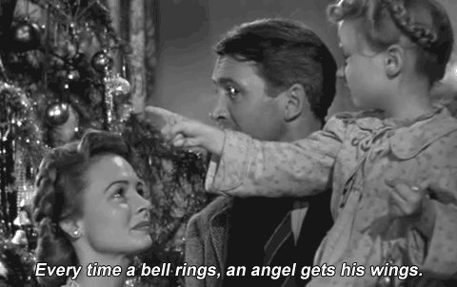

Slide 3
“Like it or hate it, you probably get tired of seeing its constant, daily reminders in TV ads and previews through November and December each year. Well, brace yourself, because up next is your industry’s rendition of ‘It’s a Wonderful Life,’ which was filmed in 1988 at the onset of UST regulations.”
“’Doing It Right’ (show photo from video in bottom right corner of screen) was probably the industry’s first instructional video following EPA’s promulgation of the federal rules for USTs in that same year.”

Slide 4
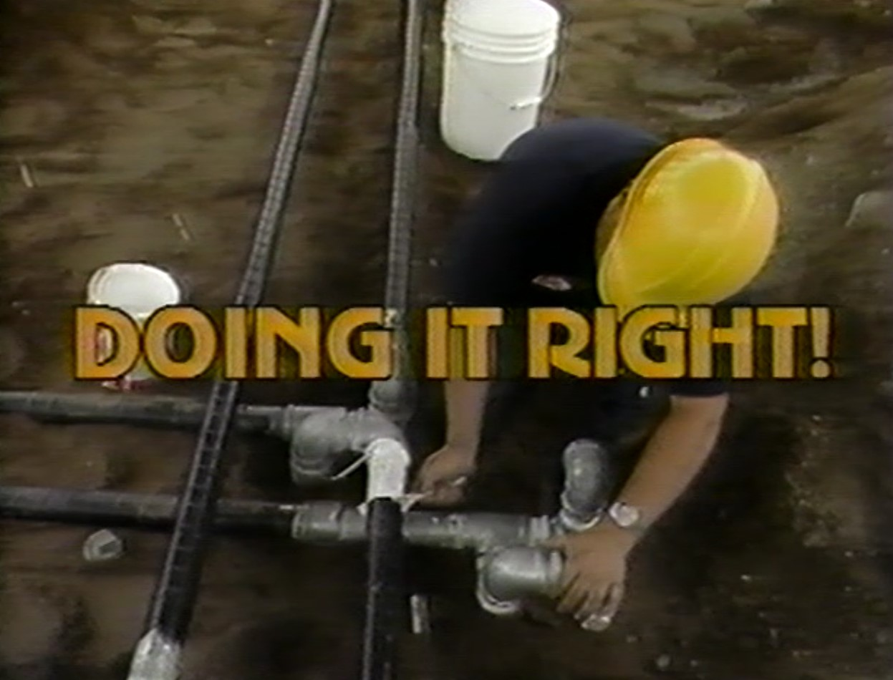

Slide 5
“Realizing this is a dreadful rerun to most of you, for I know you’ve probably seen it countless times and, not unlike the Frank Capra movie, its meaning is still just as important today. It provides good instructions on how to correctly perform UST installations.”
“Thanks to New England Interstate Water Pollution Control Commission for use of this film.”

Slide 6
2:75 min. - 330 words – 120/min.
40:00 min. Video

